Slide 1
Lab 2 Walkthrough

Slide 2
Lab 2 Components
Interconnecting Data
Data naturally contains relationships, and the relational model supports this with foreign keys and joins.
Value Manipulation
Oftentimes values must be modified from their original form rather than displayed exactly as they are stored.
We’ll learn how to enforce relationships between two tables using a foreign key constraint, how to add related data to related tables, how to ask questions and answer them using joins, and technical differences between inner, left, right, and outer joins.
We’ll learn about expressions, operands, operators, operator precedence, datatype precedence, datatype conversion, formatting functions, SQL client differences.
Advanced Data Expression
We’ll learn about Boolean expression concepts, using Boolean expressions in SQL, and creating generated columns in SQL.
Notes:
Since data naturally contains relationships, to be effective in SQL you need to know how to set them up and retrieve related data.
In many ways, the richness and complexity of the relationships in a database determines its usefulness in answering important questions about the data.
We setup relationships with foreign keys, and retrieve related data with joins.

Slide 3
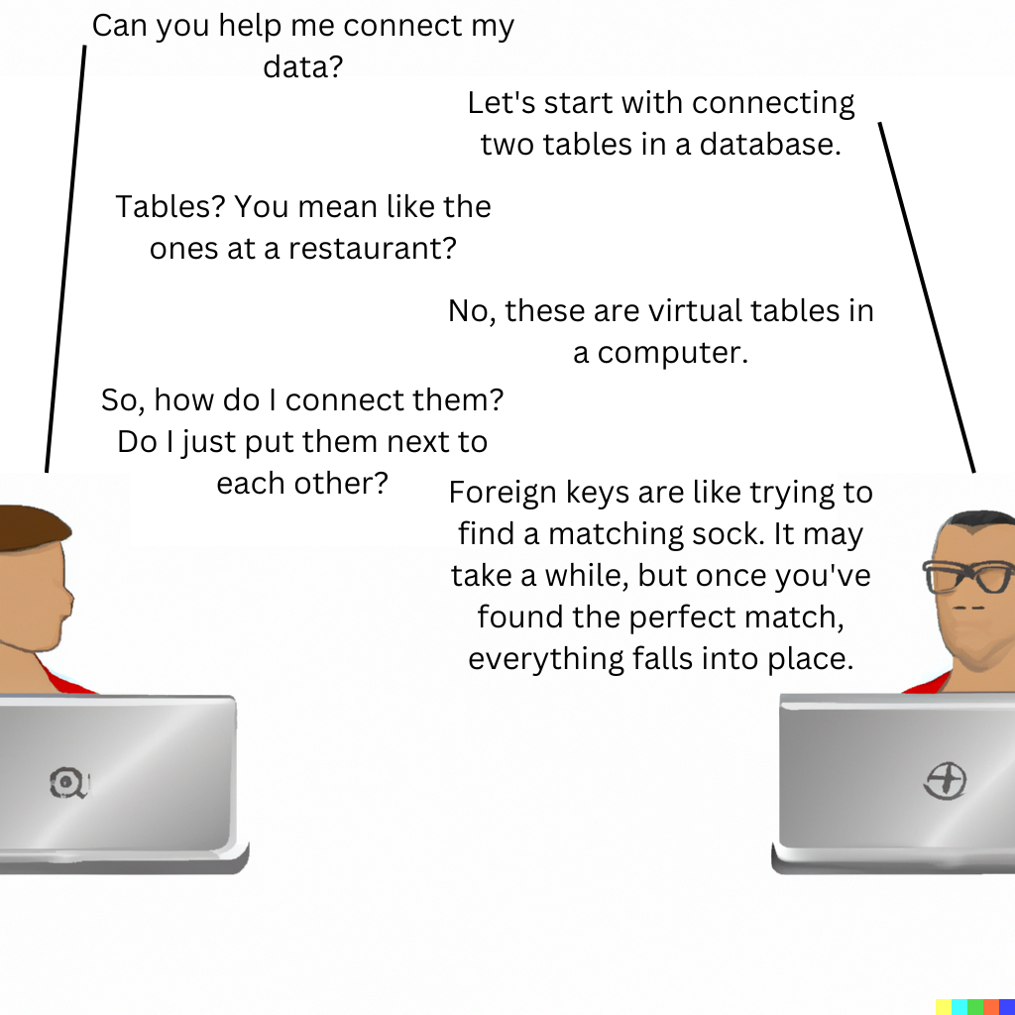
Section 1: Interconnecting Data

Slide 4
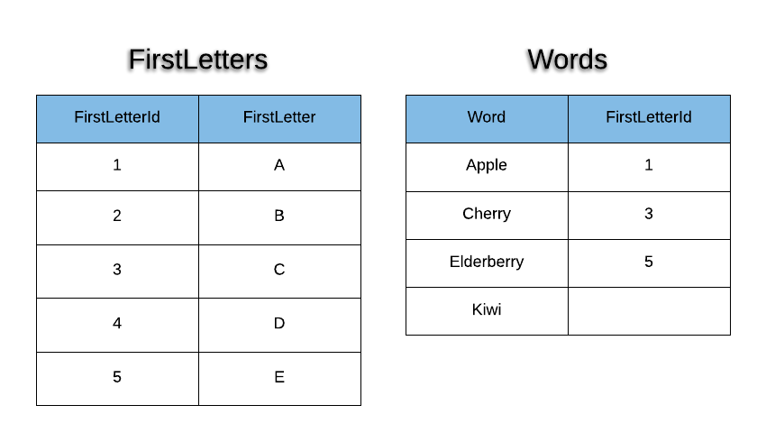
Simple Words Schema

Slide 5
StepS 1 - 3
Shown in Script

Slide 6
Step 4
Listing Matches

Slide 7
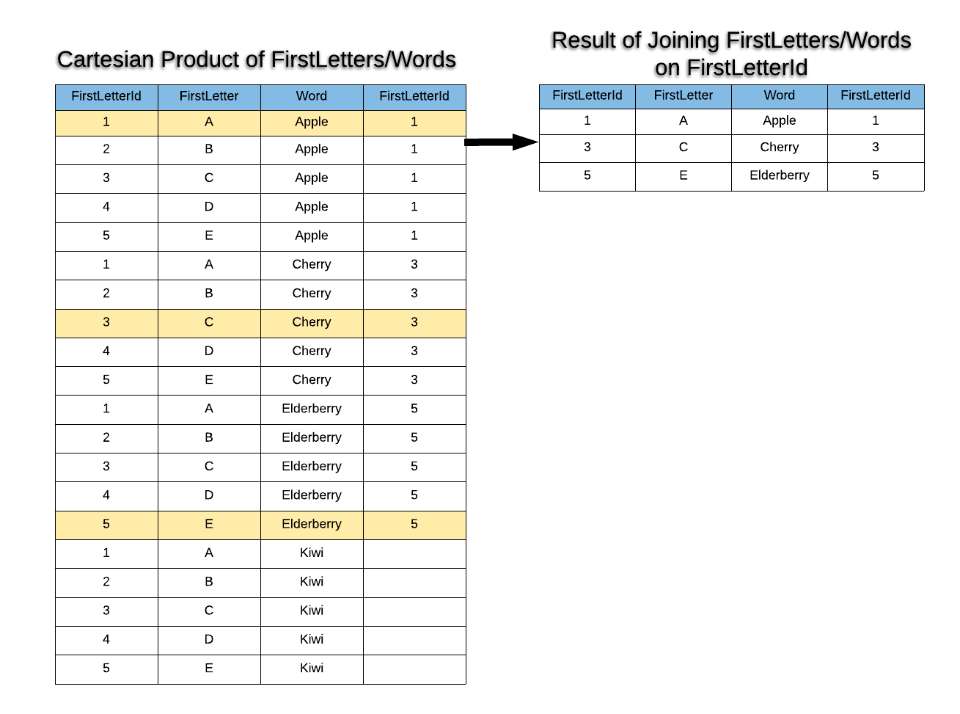
Words Inner Join Visualization
Notes:
All joins conceptually start with the cartesian product!

Slide 8
Step 5
Listing All from One Table

Slide 9
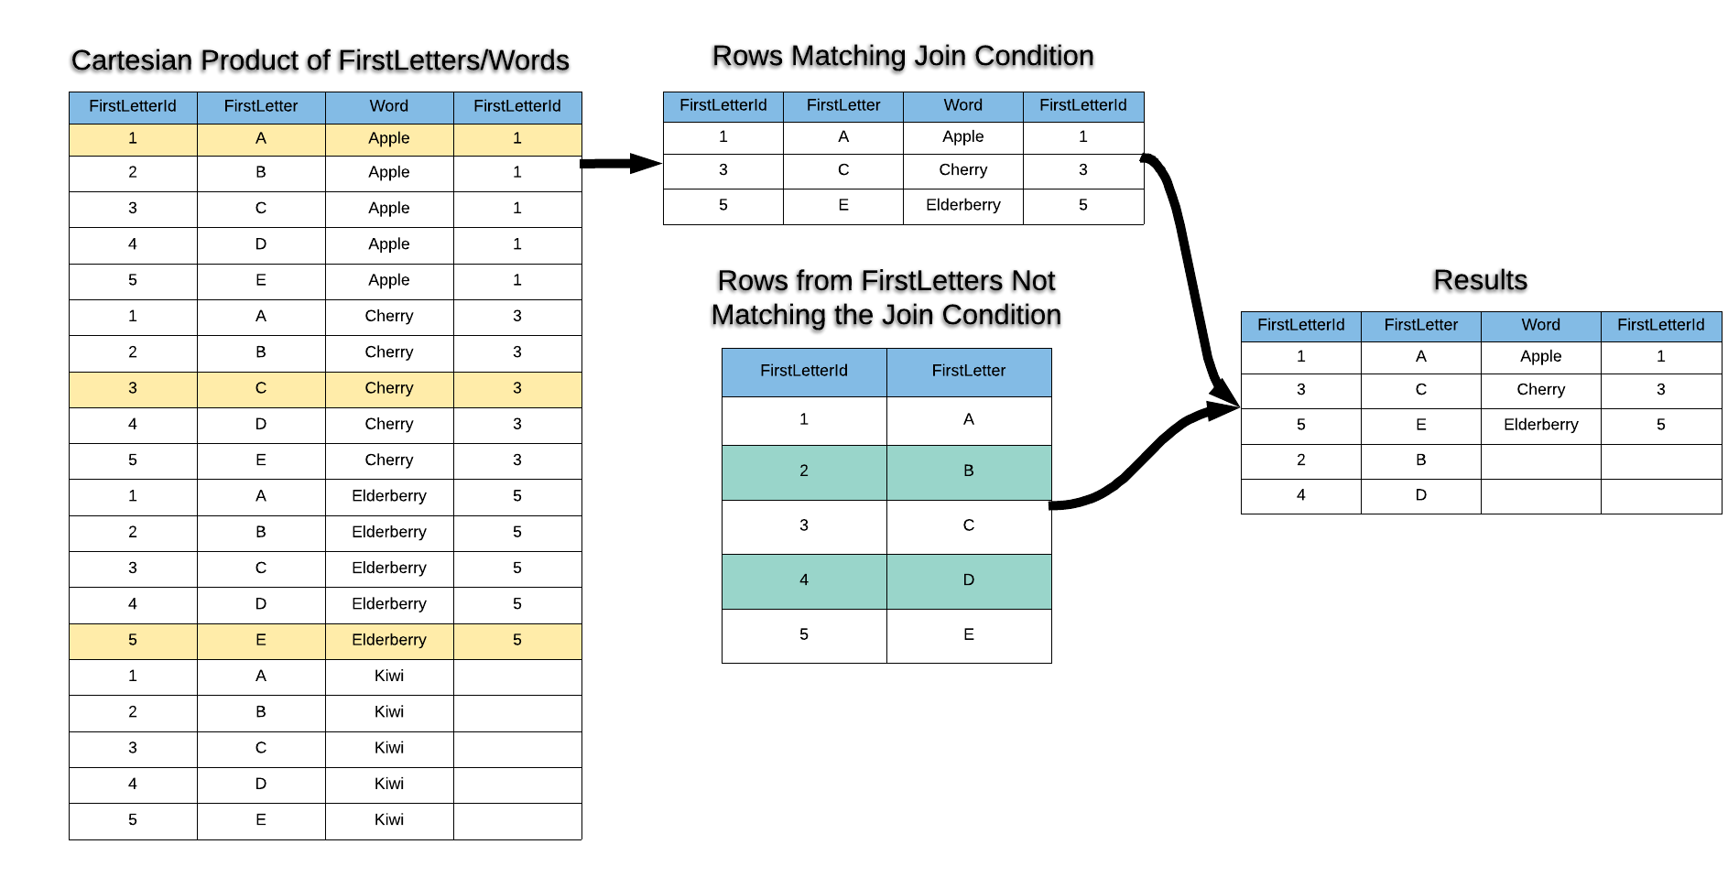
Words Left Join Visualization

Slide 10
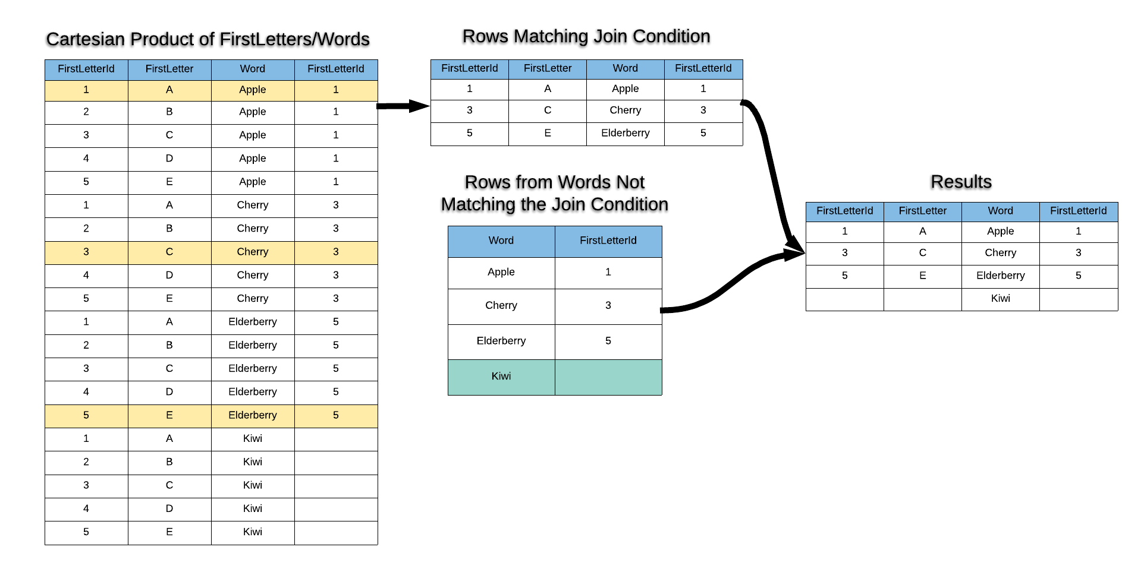
Words Right Join Visualization

Slide 11
Step 6
Listing All from Another Table
Refer to the examples in Step #5.

Slide 12
Step 7
Listing All from Both Tables

Slide 13
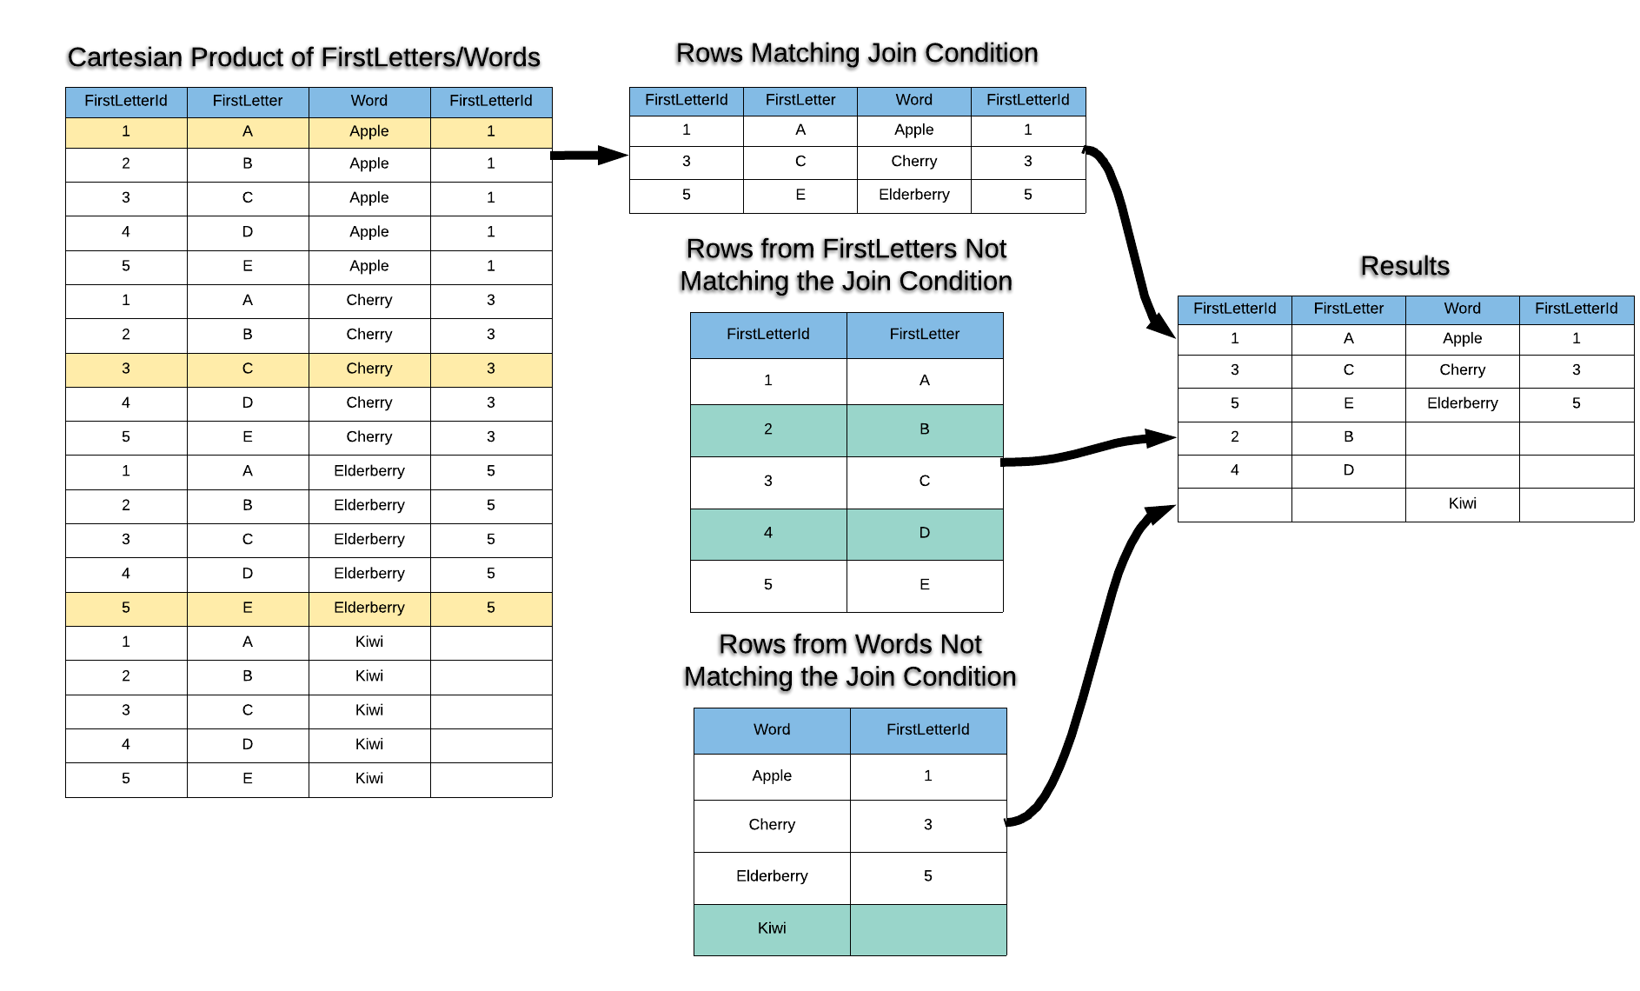
Words Outer Join Visualization

Slide 14
Section 2: Expressing Data

Slide 15
Step 8
Formatting as Money

Slide 16
Example Formatting SQL
Oracle
Postgres
SQL Server
Notes:
Formatting functions explicitly form the structure and appearance of the results.
Formatting functions tend to be DBMS specific.

Slide 17
Step 9
Using Expressions

Slide 18
Manipulating Values
It’s not always the most useful to directly display a field from the database.
Less Useful to Customer
price | tax_percent
10.99 | 4.5
More Useful to Customer
price_with_tax
$11.48
Less Useful to Customer
prefix | first_name | last_name
Mrs. | Alexa | Jones
More Useful to Customer
name
Mrs. Alexa Jones
Notes:
Pulling fields directly is not often what applications and people need to see.
We often need to manipulate, combine, format, and extract values.

Slide 19
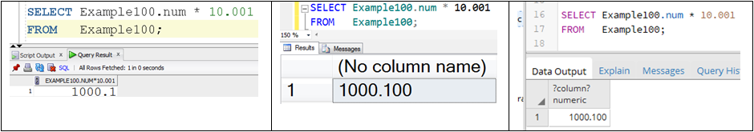
Expressions
Notes:
Manipulations on a value in a SQL query affect how the results are displayed, defined as expressions.
Expressions consist of operands, which are values from the database or hard-coded values, and operators, which are SQL keywords or symbols that derive results from one or more operands in a predefined way.

Slide 20
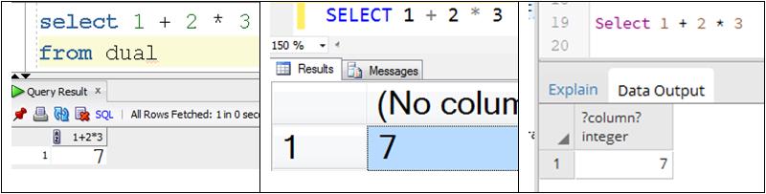
Operator Precedence
Notes:
Why isn’t the answer 9? Operator precedence!
Operator precedence is a set of rules that indicates which operations will be evaluated before other operations.
Each DBMS evaluates multiplication and division operators before addition and subtraction operators resulting in 7.
Parentheses can be used in an expression to override operator precedence.
Operator precedence is applied to all expressions in all SQL queries without variation.

Slide 21
Step 10
Advanced Formatting

Slide 22
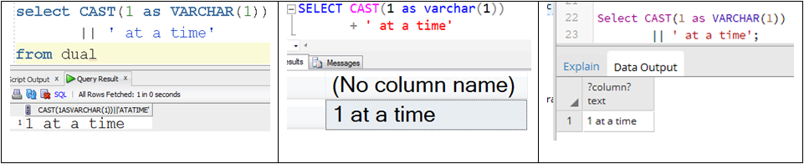
String Concatenation in SQL
Notes:
Implicit conversion happens when we don’t tell the database what to do, but it applies its own reasonable conversions, such as converting a whole number to a floating point number when added to a floating point number.
Explicit conversion happens when we control exactly the datatype of each conversion.
CAST is an ANSI way to convert.
There are also database specific ways.

Slide 23
Datatype Precedence
Every expressions’ results has a datatype.
Datatype precedence determines the datatype that results from an expression.
For example, if we add 1 + 2.33, the datatype precedence of many modern relational DBMS will cause it to be a floating point number.
If a number is concatenated with a string, the result is a string.

Slide 24
SQL Client Differences
Different SQL clients may display the same results differently.
Oracle SQL Developer displays “93.000000” as just “93”, while SSMS and Postgres display it as “93.0000” by default.
Each team or vendor creating its SQL client decides independently how results should be displayed, and different teams make different choices.
Each SQL client is just an application.

Slide 25
Section 3: ADVANCED DATA EXPRESSION

Slide 26
Step 11
Evaluating Boolean Expressions

Slide 27
AND Truth Table
True AND True = True
True AND False = False
False AND True = False
False AND False = False

Slide 28
OR Truth Table
True OR True = True
True OR False = True
False OR True = True
False OR False = False

Slide 29
NOT Truth Table
Not True = False
NOT False = True

Slide 30
Example Boolean Expression
(true and false) AND NOT(true OR false) OR (false AND true)
false AND NOT(true) OR false
false AND false OR false
false OR false
false

Slide 31
Step 12
Using Boolean Expressions in Queries

Slide 32
Business Driven Queries
In the real world, queries are written to address important business scenarios.
The user needs to see something specific, and the database developer writes the query to address it.
The database developer oftentimes needs mastery of advanced SQL constructs to address the scenarios properly.

Slide 33
Example Technologist Schema

Slide 34
Step 13
Using Generated Columns

Slide 35
Subtraction Table
CREATE TABLE Subtraction (
x DECIMAL(4) NOT NULL,
y DECIMAL(4) NOT NULL,
subtraction AS (x-y));
ORACLE/SQL SERVER
CREATE TABLE Subtraction (
x DECIMAL(4) NOT NULL,
y DECIMAL(4) NOT NULL,
subtraction DECIMAL(12)GENERATED ALWAYS AS (x-y) STORED);
POSTGRES

Slide 36
Sections 1 and 2 Evaluation
What is Measured | Achieving an A+
This measures the correctness of the SQL results, the appropriateness of the SQL constructs used, how well the section is presented, and the quality of the supporting explanations. | Entirely correct results All constructs appropriate Excellent presentation Excellent supporting explanations

Slide 37
Section 3 Evaluation
Aspect | What is Measured | Achieving an A+
Section 3: #11 Soundness | For #11, this measures the correctness of the results and the accuracy of the step-by-step work. | Results entirely correct Work entirely accurate
Section 3: #12a Soundness | For #12a, this measures the correctness of the rows listed and the soundness of the logic used in the query. | Rows entirely correct All non-matching rows excluded Logic entirely sound
Section 3: #12b Soundness | For #12b, this measures the soundness of the condition, the accuracy of the logic used in the query, and the correctness of the results. | Condition includes required columns Condition has reasonable complexity Logic entirely accurate Results entirely correct
Section 3: #13 Soundness | For #13, this measures the accuracy of the values for the generated columns, the accuracy of the logic, and the applicability of the columns included in the results. | Values for generated columns entirely accurate Logic is entirely accurate Only meaningful columns included

Slide 38

End

